Slide 1
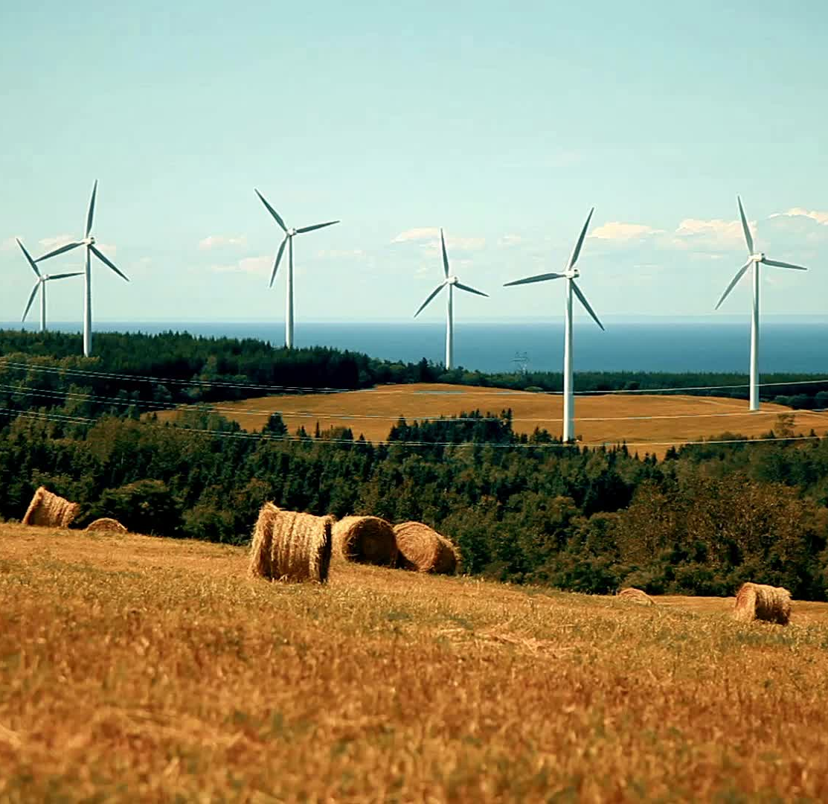
Predicting Climate Temperature from Agricultural Emissions Using FAO and IPCC Data to Support Sustainable Agriculture
Lorian Barrett
7 Sept 2025

Slide 2
Why this matters
Climate Crisis
Agriculture affects global temperature
Food Security
Rising temperatures threaten global food production
Policy Gap
Need data-driven insights for sustainable agriculture policies

Slide 3

What we wanted to find out
Which agri-food activities most strongly correlate with temperature changes?
Can we predict temperature from agricultural emission patterns?
What actionable insights can guide policy and business decisions?

Slide 4

How we Tackled the Problem
Data Foundation
965 records from 236 countries (1990-2009)
Cleaned missing values and selected key variables
Pattern Discovery
Analyzed temperature trends over 20 years
Identified strongest emission-temperature correlations
Model Development
Tested 3 prediction approaches:
Linear Regression (baseline)
Ridge Regression (handles complexity)
Random Forest (captures interactions)
Validation and Selection
Compared accuracy using R² and RMSE
Selected best model for recommendations

Slide 5

Dataset Overview
Data Specifications
Source: FAO Global Agri-Food Emissions Database + Climate Data
Scale: 6,965 records across 236 countries/areas
Timeframe: 1990-2009 (20 years)
Variables: 30 emission sources + temperature data
Key Variables
Target: Average Temperature (°C)
Emissions: Forest fires, Rice cultivation, Fertilizers, Transport, etc.
Population: Rural/Urban demographics
Geography: Country-level analysis
*Variable selection methodology detailed in Appendix A

Slide 6

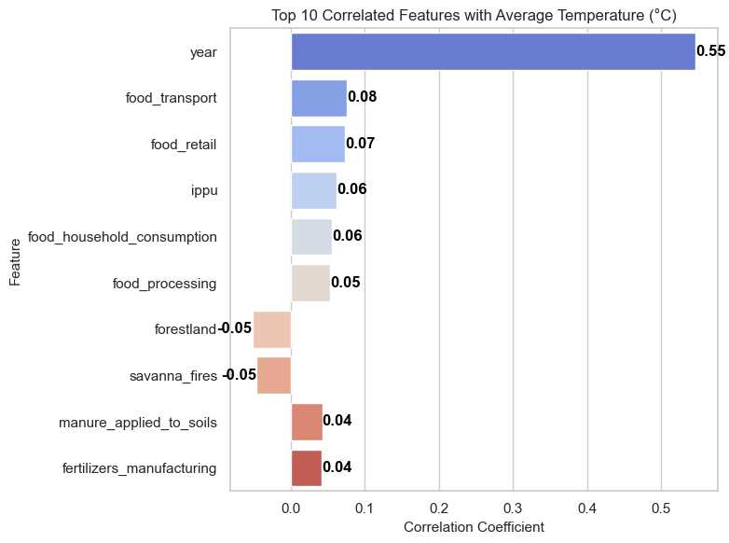
What Drives Temperature
Most Important Relationships
Year: 0.546 correlation (strongest predictor)
Food Transport: 0.076 (supply chain impact)
Food Retail: 0.073 (distribution systems)
IPPI( Industrial Manufacturing): 0.062 (production processes)
Food Household Consumption: 0.056 (consumer behavior)

Slide 7
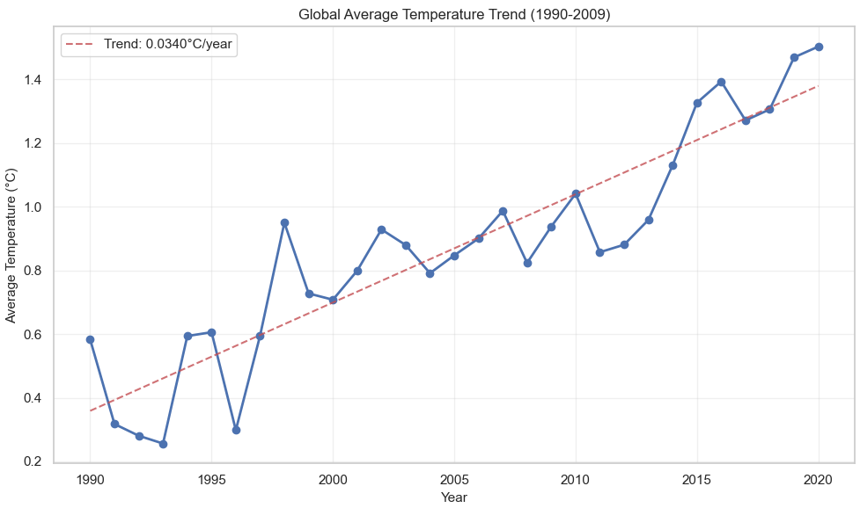
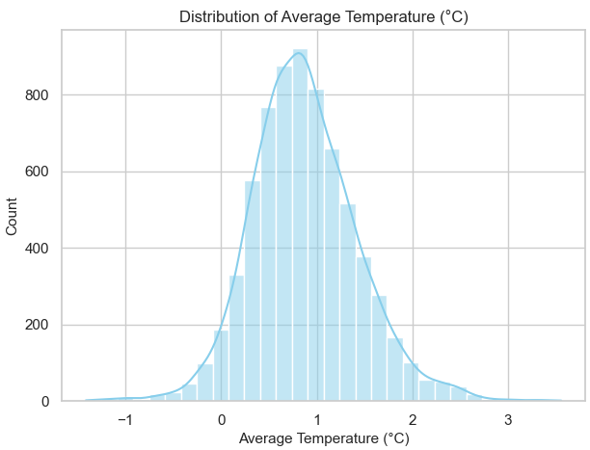
Key Patterns we Found
Temperature Change Distribution (1990-2009)
Most countries experienced 0.5-1.2°C warming
Range: -1.4°C to +3.6°C across all records
Average increase: 0.87°C above baseline
Shows global variation in climate response
Global Warming Trend Over Time
Clear upward trend from 1990-2009
Consistent year-over-year temperature increases
Year is our strongest predictor (correlation: 0.546)
Demonstrates accelerating climate change during study period

Slide 8

Key Patterns
Temperature Change Distribution (1990-2009)
Most countries experienced 0.5-1.2°C warming
Range: -1.4°C to +3.6°C across all records
Average increase: 0.87°C above baseline
Shows global variation in climate response
Global Warming Trend Over Time
Clear upward trend from 1990-2009
Consistent year-over-year temperature increases
Year is our strongest predictor (correlation: 0.546)
Demonstrates accelerating climate change during study period

Slide 9
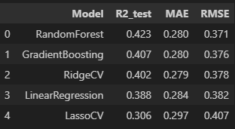
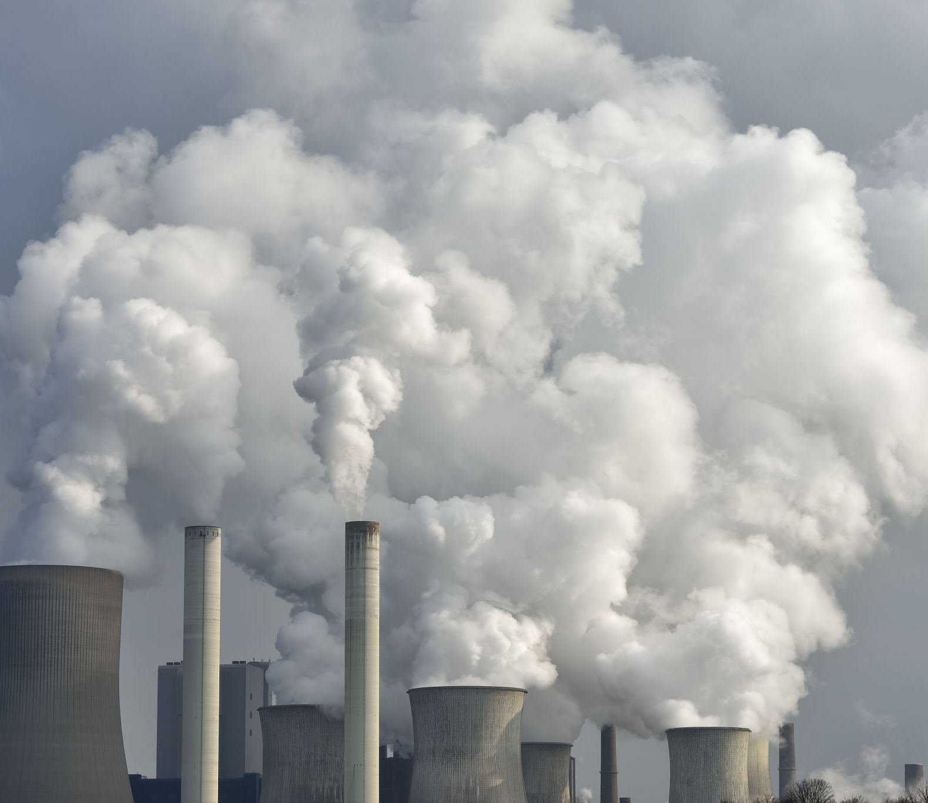
The Models we Tested
Random Forest model predicted 42% of temperature changes
Accuracy: Within ±0.37°C of actual temperatures
Key finding: Tree-based models outperformed linear approaches
Bottom line: Useful for planning, but climate relationships are complex

Slide 10

Key Takeaways
Clear warming trend: 0.87°C average increase (1990-2009)
Best predictor: Year (0.546 correlation) shows accelerating change
Agricultural factors: Supply chain (transport/retail) matter most
Model performance:
Random Forest achieved 42% accuracyPolicy focus:
Target food systems, not just farm-level emissions

Slide 11

Business & Policy Insights
Policymakers
Focus on food transport/retail emission standards
Use time-based models for climate forecasting
Address supply chain efficiency regulations
Plan for 0.05°C/year continued warming
Agricultural Businesses
Prioritize logistics and distribution improvements
Invest in transport efficiency technologies
Monitor supply chain carbon footprint
Prepare operations for temperature increases
Researchers & Analysts
Include more recent post-2009 data
Investigate external climate variables
Explore sector-specific emission impacts
Develop ensemble prediction models

Slide 12

Limitations and Future Work
Current Limitations
Model Performance: Only 42% variance explained - significant factors missing
Data Window: Limited to 1990-2009, missing recent climate acceleration
Correlation Focus: Agricultural emissions showed weaker relationships than expected
Geographic Scope: Country-level data may miss local agricultural variations
Future Improvements
Recent Data: Extend analysis through 2020s for current patterns
Climate Variables: Include precipitation, extreme weather events
Sector Specificity: Separate crop types, farming practices by region
Lag Analysis: Test time delays between emissions and temperature response

Slide 13
Appendix

Slide 14
Appendix A: Variable Selection Criteria
1. Data Completeness Analysis (Section 3.2)
Prioritized variables with complete data (0 missing values)
Available options: total_emission, Rice Cultivation, Food Transport, Food Retail, Food Processing, Fertilizers Manufacturing, all population variables
2. Correlation Analysis (Section 5.3)
Selected variables with strongest correlations to temperature
Top agricultural factors: Food Transport (0.076), Food Retail (0.073)
3. Project Alignment (Section 1.3)
Focused on agricultural emission sources relevant to stakeholders
Emphasized actionable variables for policy/business decisions
4. Modeling Considerations
Limited to manageable number of interpretable variables
Avoided redundant population metrics

Slide 15

Appendix B: Trello Board Project Plan

